Slide 1
DDSAnalytics Attrition Rates
An Exploratory Data Analysis
Data Team
Alec Lepe & Che’ Cobb
November 28, 2018

Slide 2
Agenda with EDA
Understand the Data Structure
Leading Factors for Employee Attrition
Identify the trends and variables
Build a predictive model
Project Github repository:
https://github.com/lepealec/MSDS-6306-Second-Case-Study

Slide 3
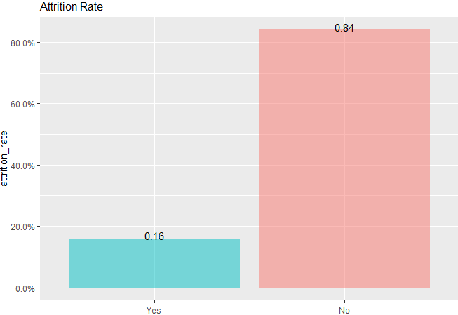
Data Analysis and Cleaning
There are 35 separate variables, including attrition
Attrition Count is about 16%
Eliminated Non relevant data with little information:
"EmployeeCount“ “Over18” “StandardHours

Slide 4
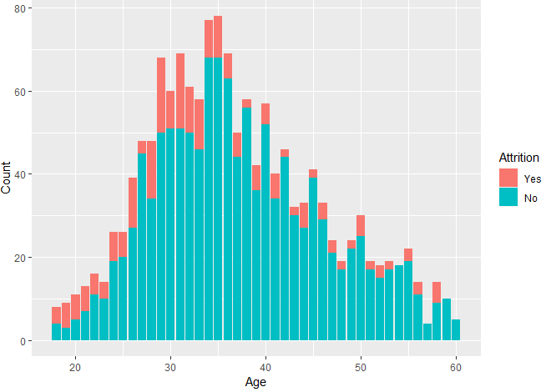
Most Popular ages(28-35)

Slide 5
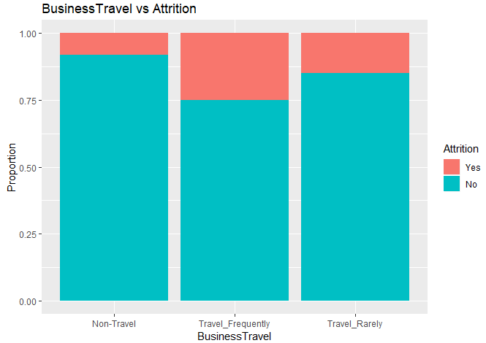
People who travel are more than likely to have more attrition

Slide 6
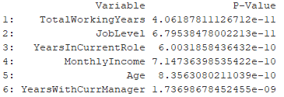
Automatically detecting good single predictors
Top Predictors by p-value

Slide 7
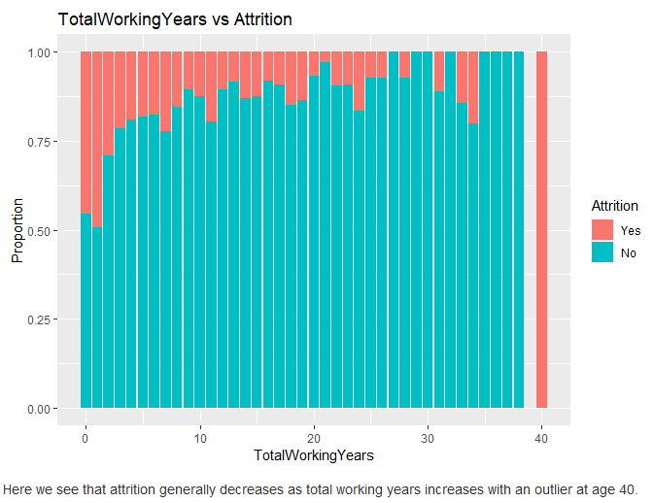
TotalWorkingYears

Slide 8
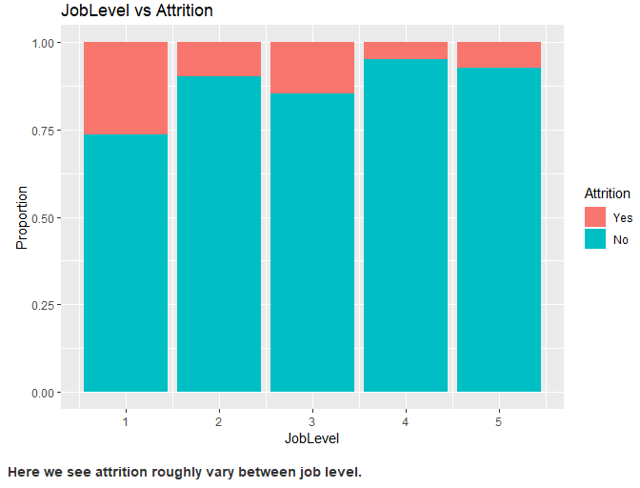
JobLevel

Slide 9
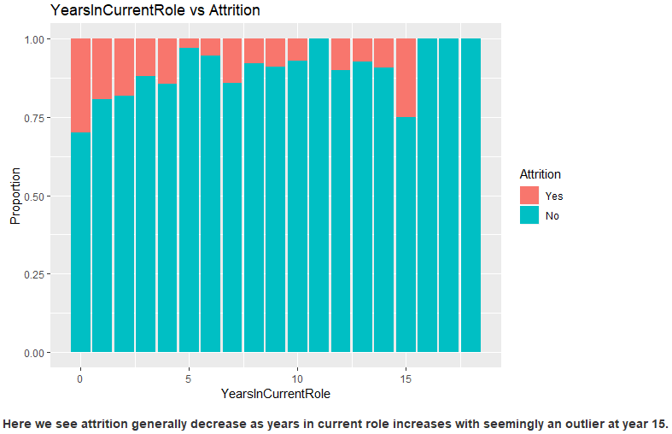
YearsInCurrentRole

Slide 10
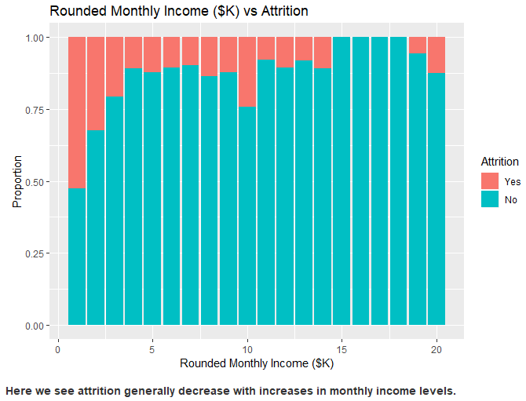
MonthlyIncome

Slide 11
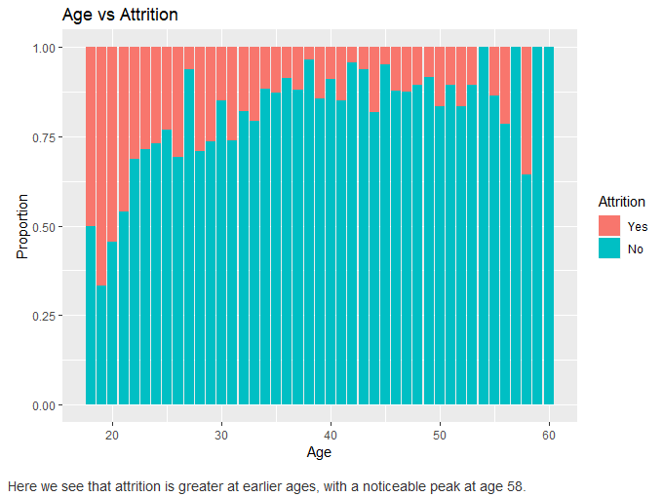
Age

Slide 12
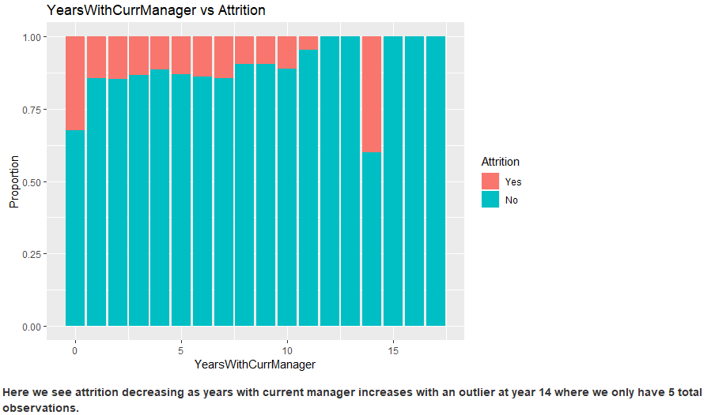
YearsWithCurrentManager

Slide 13
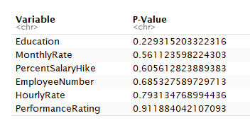
Worse Predictors
Top 6

Slide 14
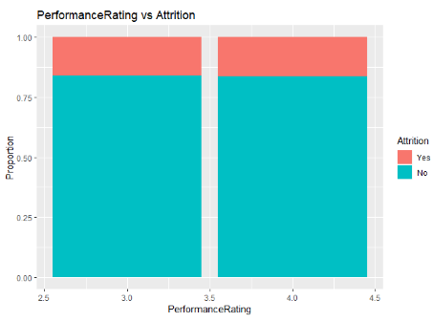
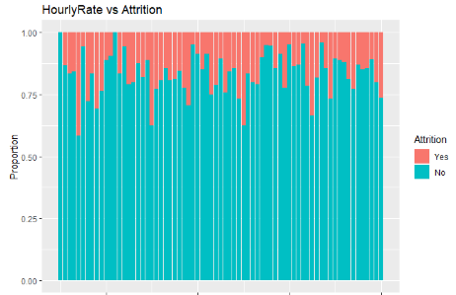
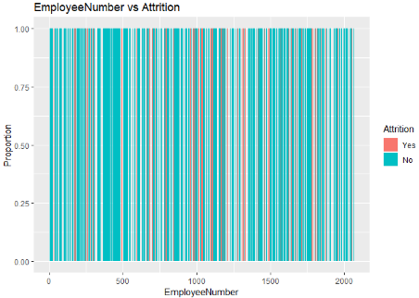
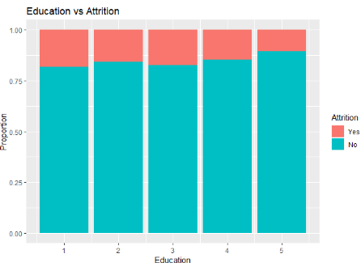
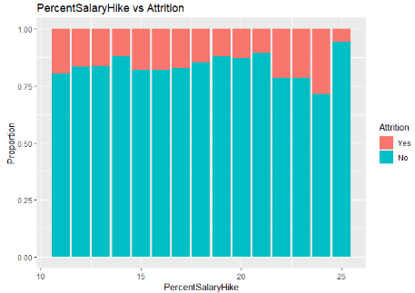
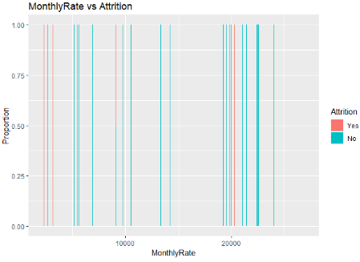
Graphs of Worst Predictors

Slide 17
Conclusion
Top 3 Variables
TotalWorkingYears
JobLevel
YearsinCurrentRole
Top 3 parameters from logistic model
OverTime
EnvironmentSatisfaction
NumCompaniesWorked

